Slide 1
EXECUTIVE REPORT | SOT vs. CASHIER STAFFING
Executive Summary
111/hr
Shared kitchen ceiling
132/hr
Cashier register ceiling
175/hr
SOT kiosk ceiling
10 min
P99 SLA target
KEY FINDING
HEADLINE RESULT
The shared kitchen's 111/hr ceiling sits close to the Human Cashier's own 132/hr register ceiling, and well below the Self-Order Terminal (SOT)'s 175/hr kiosk ceiling.
The kitchen -- not either front end -- is the real constraint for both scenarios.
P99-safe capacity: Human Cashier ~92.2/hr vs. Self-Order Terminal (SOT) ~89.6/hr.
A modest, not decisive, edge -- once the kitchen is a genuine co-bottleneck, extra kiosks buy little and the SOT's slower per-transaction time becomes a small net cost.
Discrete-Event Simulation (SimPy) | Order + Kitchen Tandem Queue, P99 SLA
01/08

Slide 2
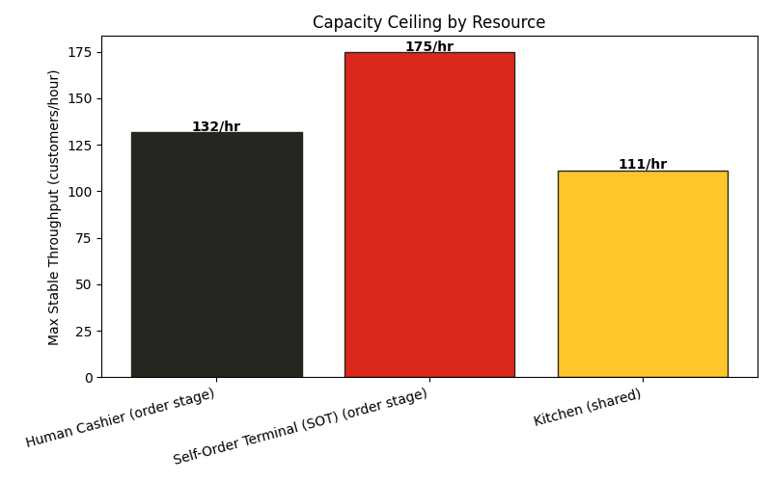
EXECUTIVE REPORT | SOT vs. CASHIER STAFFING
The Kitchen Is a Shared Bottleneck
MAX STABLE THROUGHPUT BY RESOURCE
WHY THIS MATTERS
Every restaurant has 3 constraints, not 1: registers, kiosks, and the kitchen behind both.
Here the kitchen caps at 111/hr -- below the Self-Order Terminal (SOT)'s 175/hr kiosk capacity.
Installing more kiosks only helps up to the kitchen's own ceiling. Past that, extra front-end capacity is wasted.
Kitchen and order-taking AHT figures are illustrative assumptions, checked against published QSR benchmarks -- see the notebook for sourcing.
Discrete-Event Simulation (SimPy) | Order + Kitchen Tandem Queue, P99 SLA
02/08

Slide 3
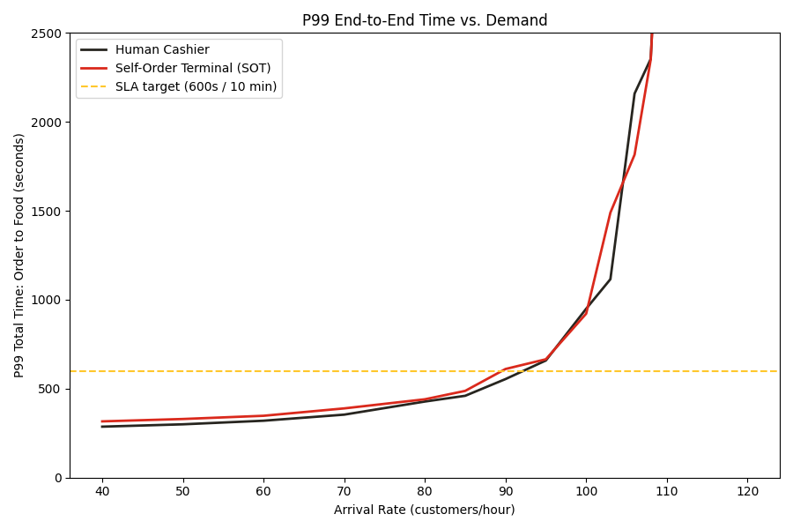
EXECUTIVE REPORT | SOT vs. CASHIER STAFFING
P99 Time Vs. Demand
P99 END-TO-END TIME: ORDER TO FOOD
P99-SAFE CAPACITY
92.2/hr
Human Cashier
89.6/hr
Self-Order Terminal (SOT)
Below this capacity, both scenarios comfortably clear the SLA; past it, P99 time explodes for both as the shared kitchen saturates.
Discrete-Event Simulation (SimPy) | Order + Kitchen Tandem Queue, P99 SLA
03/08

Slide 4
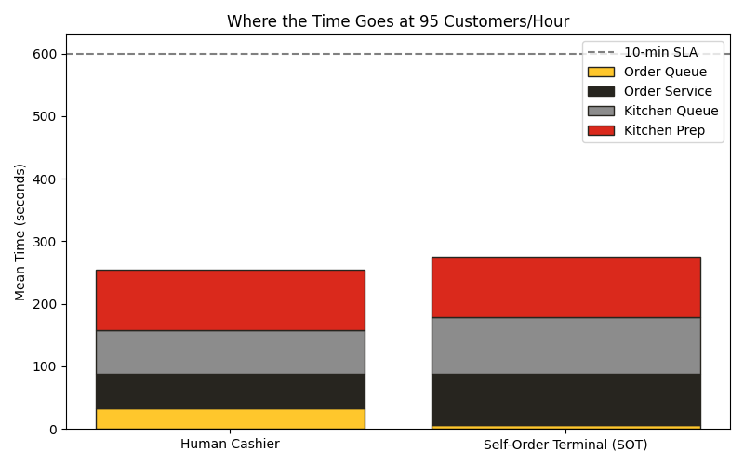
EXECUTIVE REPORT | SOT vs. CASHIER STAFFING
Where the Time Goes Under Stress
STAGE BREAKDOWN AT 95 CUSTOMERS/HOUR
MEAN SECONDS BY STAGE
Stage
Human Cashier
Self-Order Terminal (SOT)
Order queue
33s
6s
Order service
55s
82s
Kitchen queue
69s
90s
Kitchen prep
97s
97s
P99 total
708s
726s
% within SLA
97.7%
97.4%
Stress test at 95/hr, close to the shared kitchen's theoretical ceiling. Values pooled across multiple simulation replications.
Discrete-Event Simulation (SimPy) | Order + Kitchen Tandem Queue, P99 SLA
04/08

Slide 5
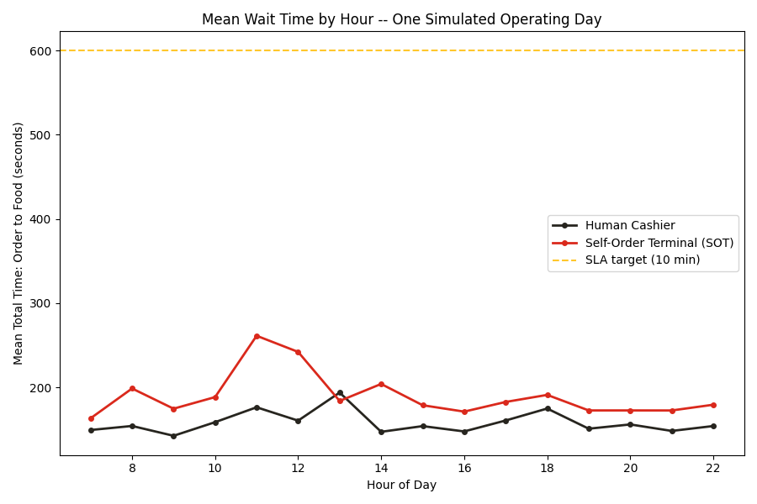
EXECUTIVE REPORT | SOT vs. CASHIER STAFFING
One Realistic Operating Day
MEAN WAIT TIME BY HOUR (07:00-23:00)
DAILY VALIDATION
1,276
Customers served, both scenarios
0
SLA breaches all day
Mean total time: Cashier 163s vs. SOT 201s.
Worst case: 363s vs. 516s.
One simulated day with a lunch peak and a smaller after-office/dinner peak in demand -- both scenarios hold the SLA, but the SOT runs with less headroom.
Discrete-Event Simulation (SimPy) | Order + Kitchen Tandem Queue, P99 SLA
05/08

Slide 6
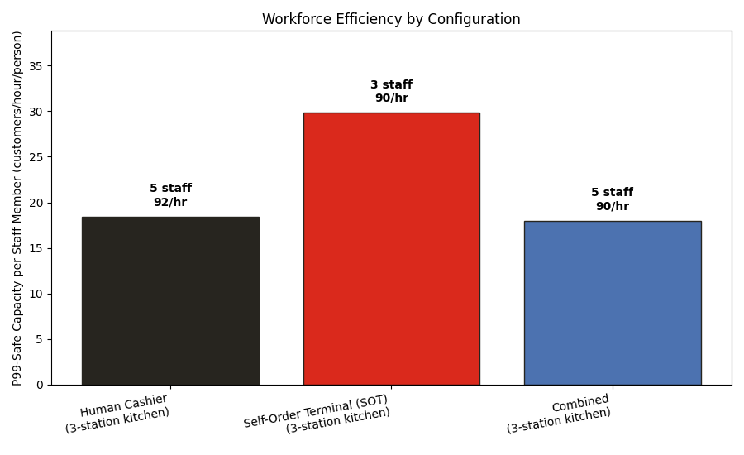
EXECUTIVE REPORT | SOT vs. CASHIER STAFFING
Which Staffing Mix Is Most Efficient?
P99-SAFE CAPACITY PER STAFF MEMBER
TODAY'S KITCHEN (3 STATIONS)
18.4/hr
Cashier -- 5 staff
29.9/hr
SOT -- 3 staff
18.0/hr
Combined -- 5 staff
Capacity per staff = P99-safe throughput / (order-taking + kitchen headcount). All three configurations deliver nearly the same throughput today -- kiosk-only does it with the fewest people.
Discrete-Event Simulation (SimPy) | Order + Kitchen Tandem Queue, P99 SLA
06/08

Slide 7
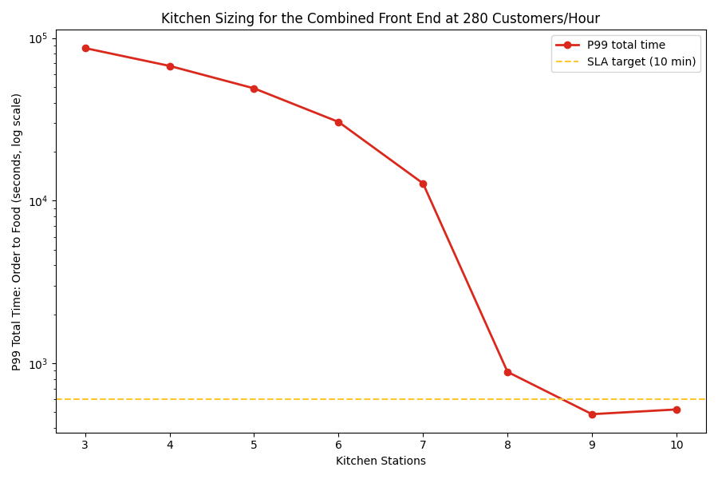
EXECUTIVE REPORT | SOT vs. CASHIER STAFFING
Sizing the Kitchen for Growth
P99 TIME vs. KITCHEN STATIONS AT 280/HR
TO REACH ~280/HR
9
Kitchen stations needed
+6
More hires than today
With that same 9-station kitchen, kiosk-only still tops out near 153/hr -- only the combined front end (~280/hr) can actually use the extra capacity.
Growth only pays off when the kitchen and the ordering channel are expanded together -- either alone leaves capacity on the table.
Discrete-Event Simulation (SimPy) | Order + Kitchen Tandem Queue, P99 SLA
07/08

Slide 8
EXECUTIVE REPORT | SOT vs. CASHIER STAFFING
Recommendations
PRIORITY ACTION
Run SOT-only today -- it matches Cashier and Combined on capacity with the fewest staff. Only add cashiers or kitchen capacity if pursuing a specific growth target.
KEY TAKEAWAYS
KIOSK-ONLY WINS TODAY
Cashier, SOT-only, and Combined all cap out at nearly the same throughput -- SOT-only delivers it with zero order-taking staff.
KITCHEN FIRST, IF GROWING
Any capacity investment should go to the kitchen before the front end -- it's the actual constraint, and combining channels alone raised capacity by ~0%.
PAIR EXPANSION CORRECTLY
A 9-station kitchen unlocks ~280/hr, but only when paired with the combined front end -- SOT-only alone can't use that capacity.
WATCH THE TAIL
A P99 SLA is far more demanding than an average-wait target -- size every capacity decision against the tail, not the mean.
Discrete-Event Simulation (SimPy) | Order + Kitchen Tandem Queue, P99 SLA
08/08

